Slide 1
eCommerce Data Analysis
-Sakshi Ukey
-Sonali Nimje
-Mukul Sheware
Guided by - Rashmi Joshi Mam
Company name - Zappkode Solution

Slide 2
contents
Introduction
Data overview
Sales analysis
Category analysis
Distribution of state
Status analysis
Product analysis
Channel analysis
Conclusion

Slide 3

Introduction
Objective:
"To analyze eCommerce data to uncover trends, identify popular products, understand customer demographics, and assess sales channels."
Tools and Libraries:
Pandas
Matplotlib
seaborn

Slide 4
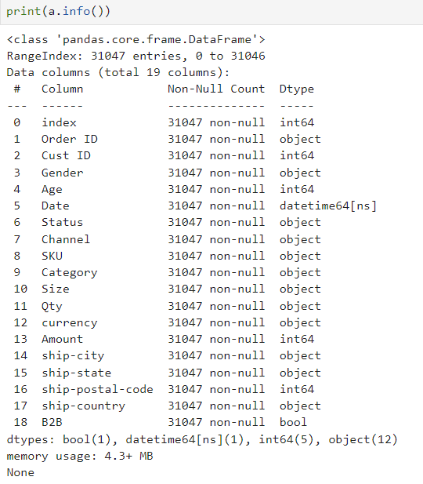
Data overview
Summary of the Dataset:
The dataset consists of 31047 rows and 19 columns, including order details, customer demographics, product information, and sales channels.
The data types include numerical (e.g., Age, Amount) and categorical (e.g., Gender, Category, Channel)

Slide 5
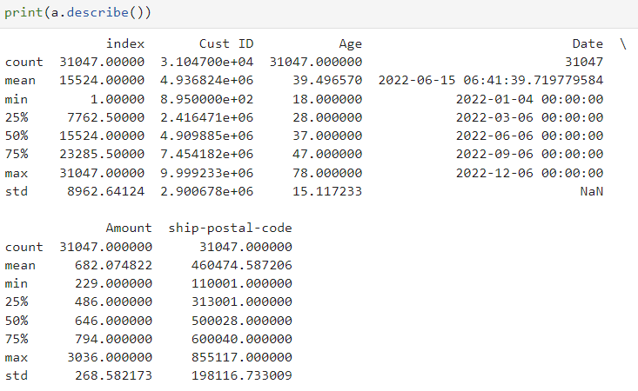
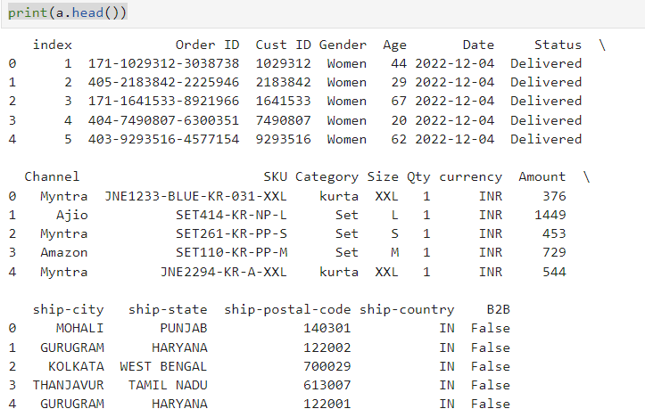
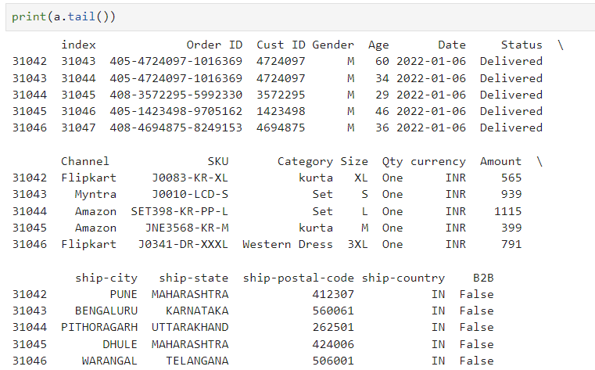

Slide 6
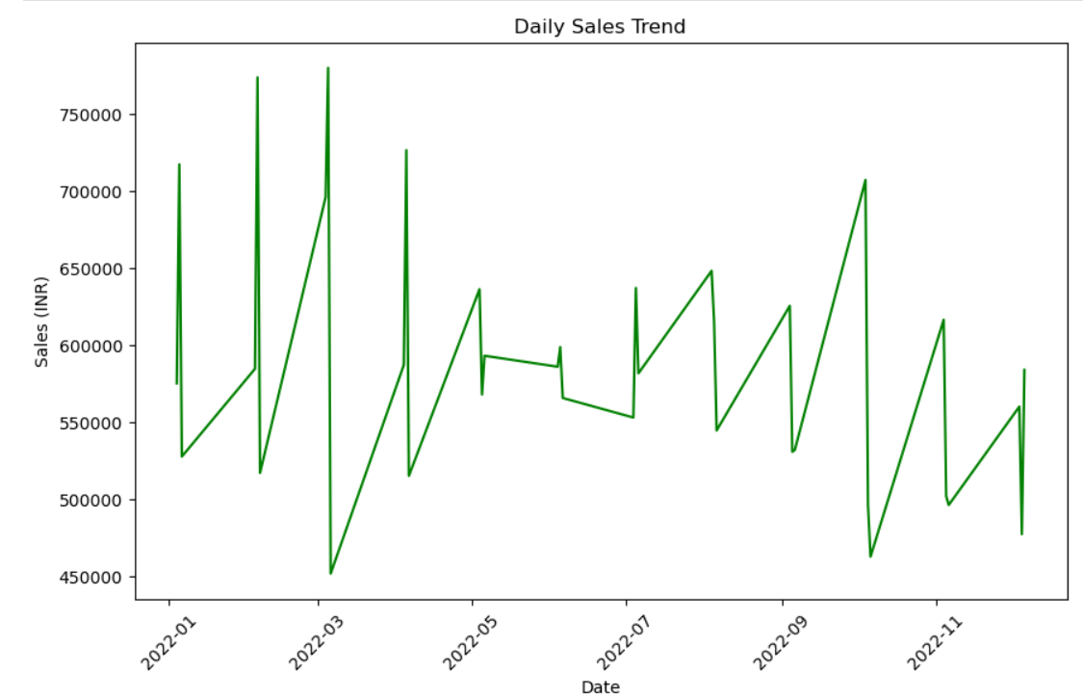
Sales Analysis
Visualize Sales Trends Over Time:

Slide 7
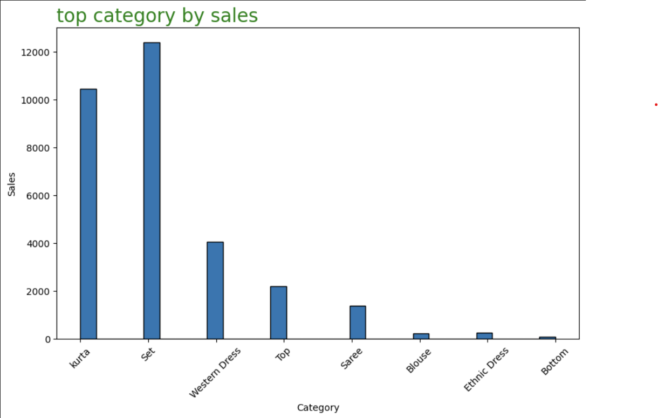
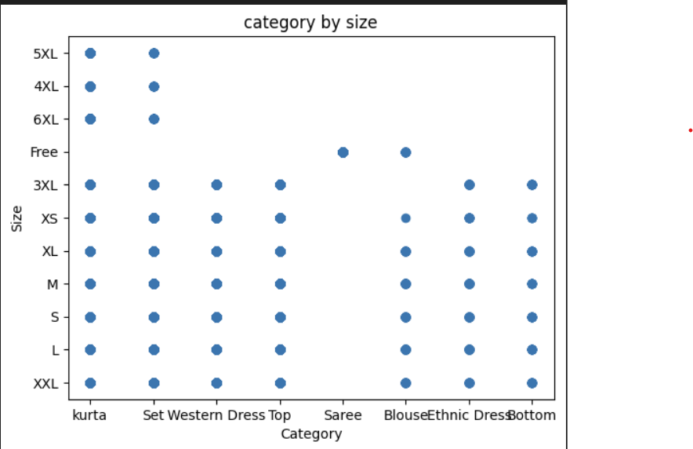
Category Analysis Category by Sales and Size

Slide 8
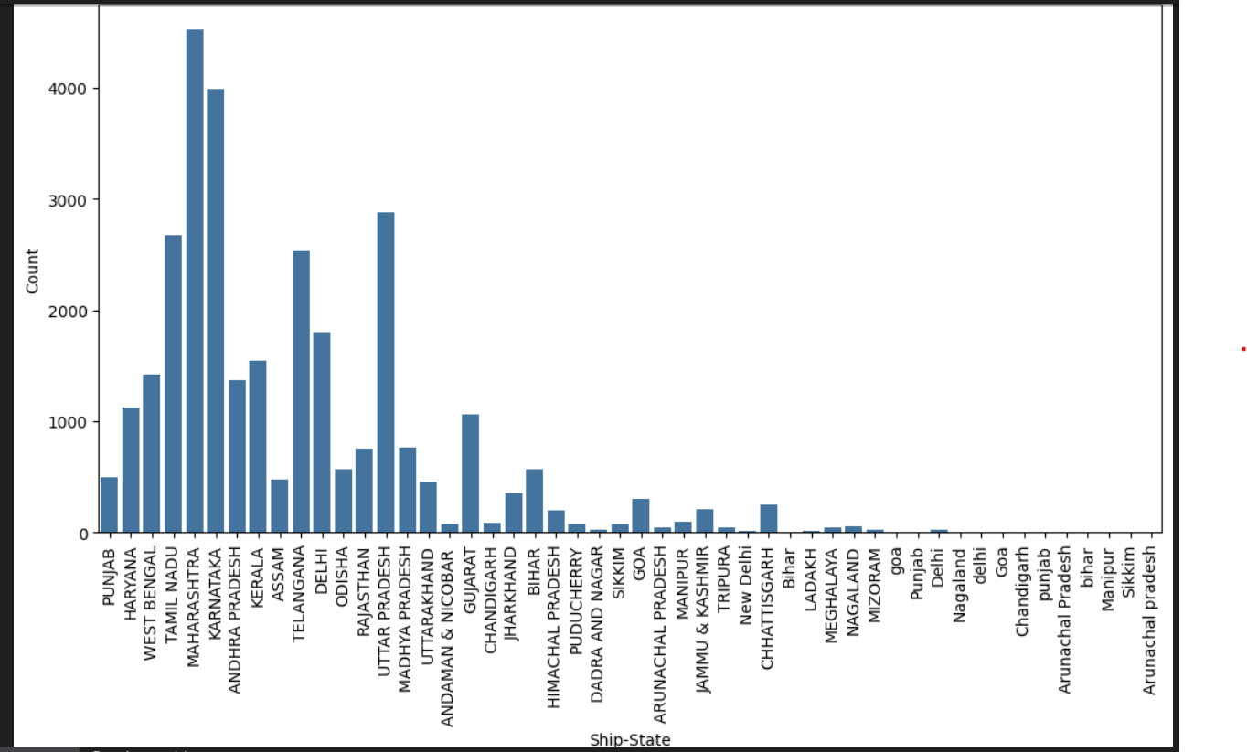
Distribution of state
Count of cities by state

Slide 9
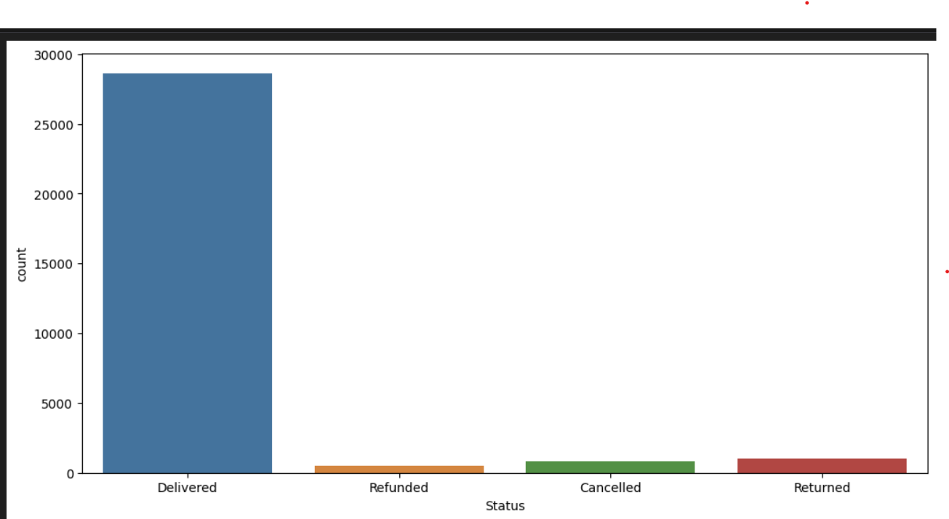
status analysis
Courier status Visualization

Slide 10
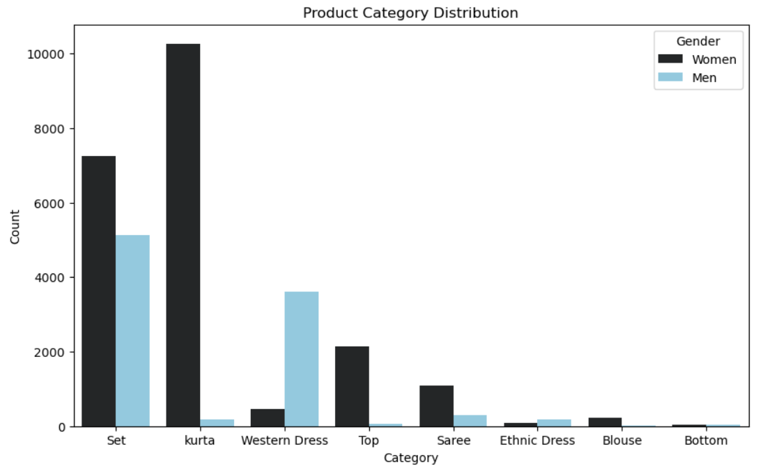
Product Analysis
Category Distribution Visualization
Popular Products

Slide 11
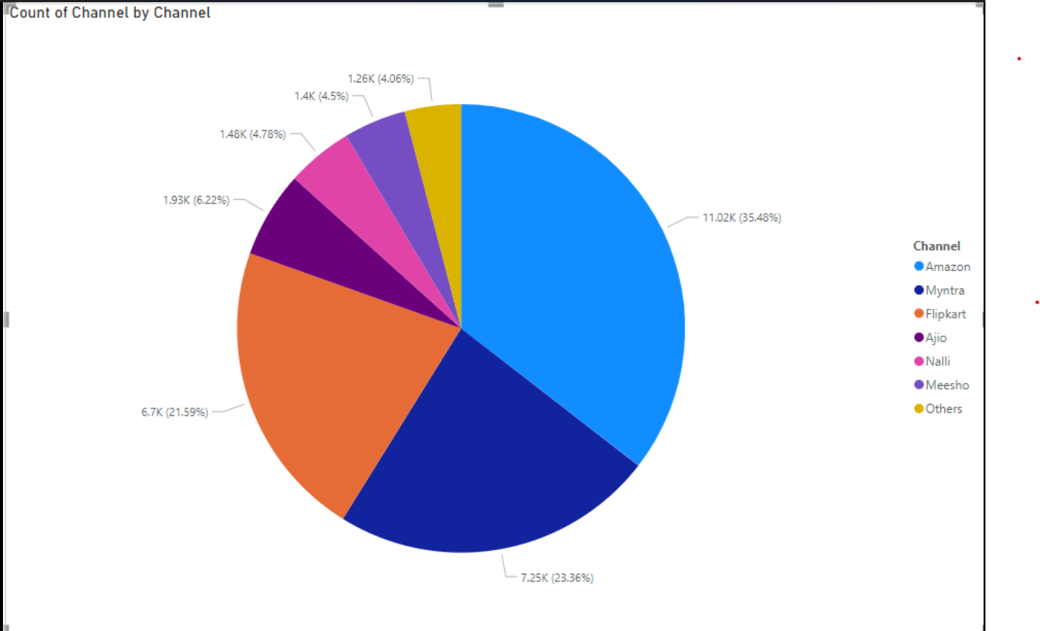
Channel Analysis
Count of channel

Slide 12
Conclusions
Sales are highest during the festive season.
The Kurta category is the most popular product among customers.
Women are the primary customer segment.
Myntra is the leading sales channel.

Slide 13
Thank you

